Slide 1
RNA Secondary Structure
Prediction
● Using Context Free Grammars ●
Ali Ahmadi Esfidi
May 2024

Slide 2
01
Overview
02
Stochastic Context Free Grammar
CONTENTS
03
Estimating Probabilities
04
Implementation
2/39

Slide 3
01
Overview

Slide 4
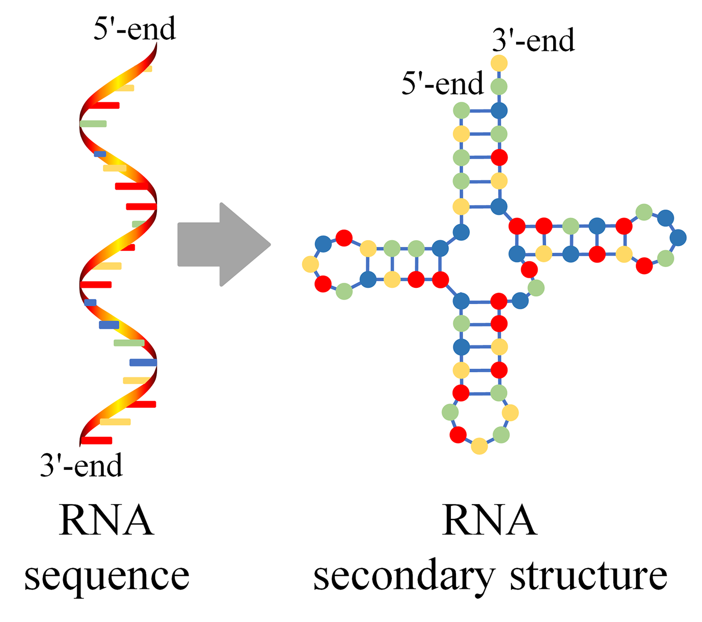
RNA Secondary Structure
4/39

Slide 5
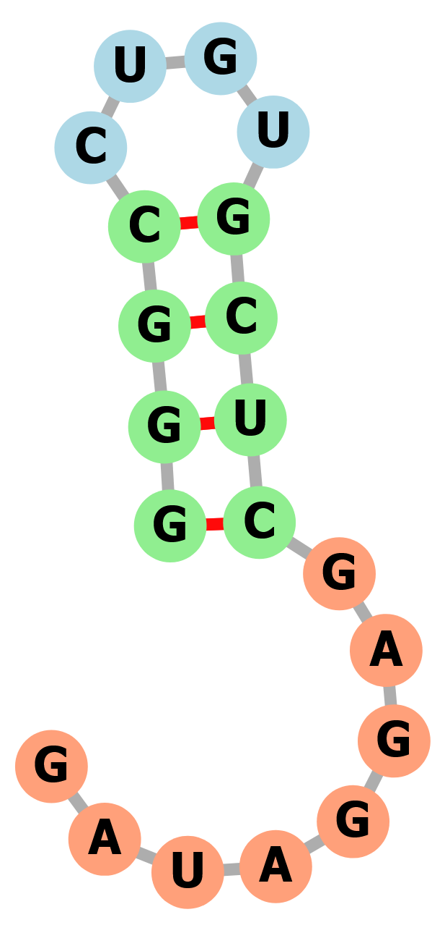
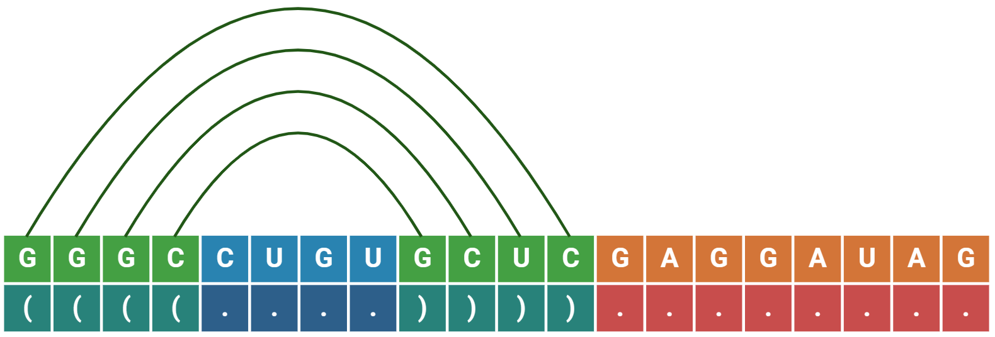
Dot Bracket Notation
Sequence: GGGCCUGUGCUCGAGGAUAG
Structure: ((((....))))........
5/39

Slide 6
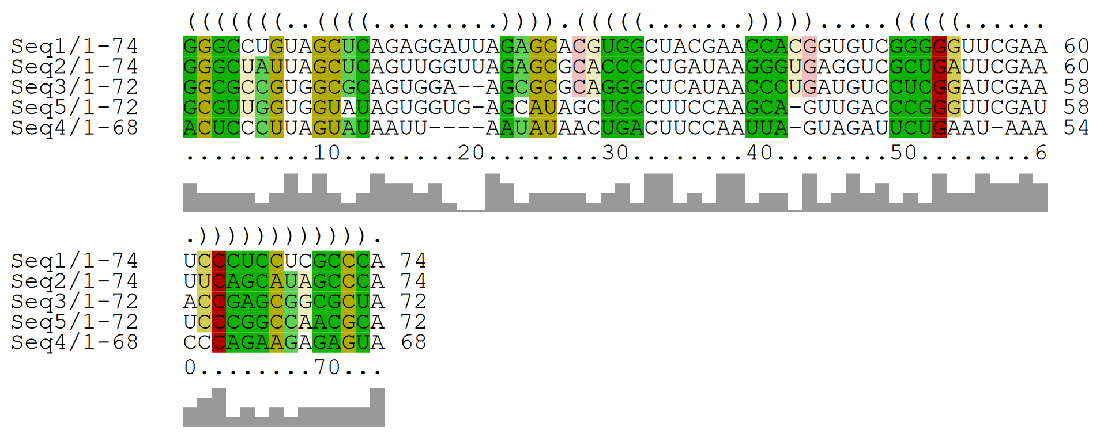
Problem
Using Stochastic Context Free Grammar !!
6/39

Slide 7
02
Stochastic Context Free Grammar

Slide 8



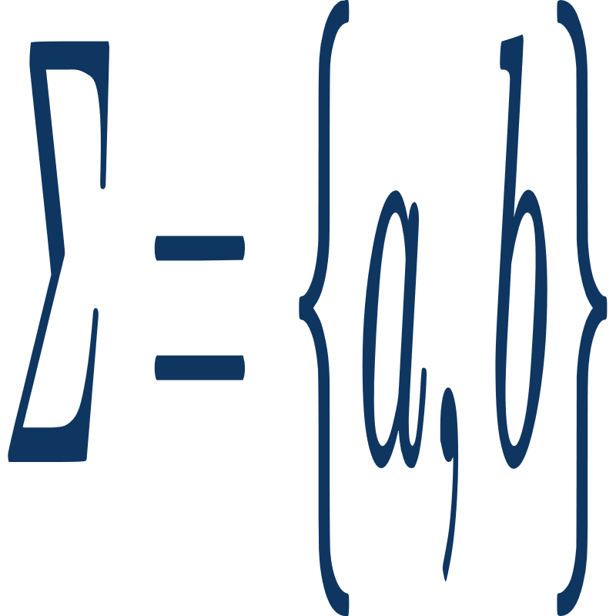






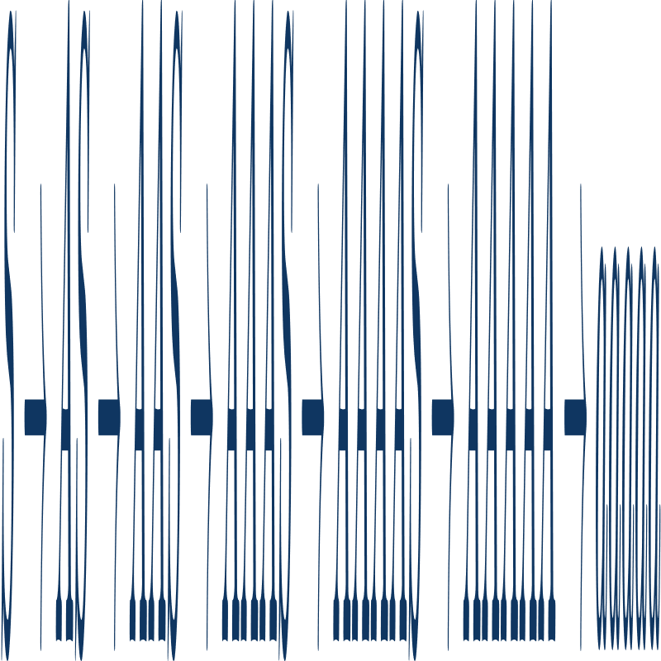
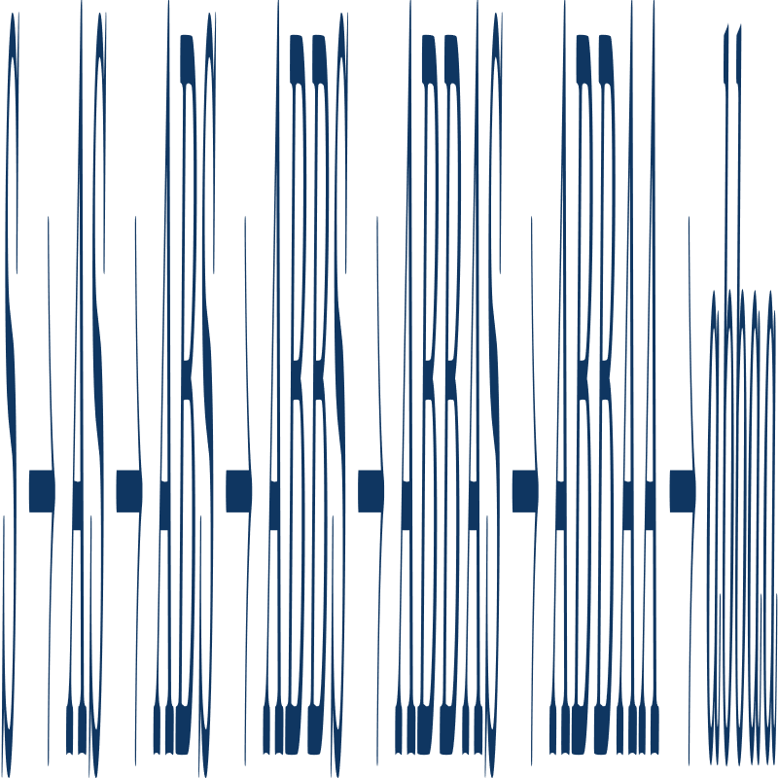
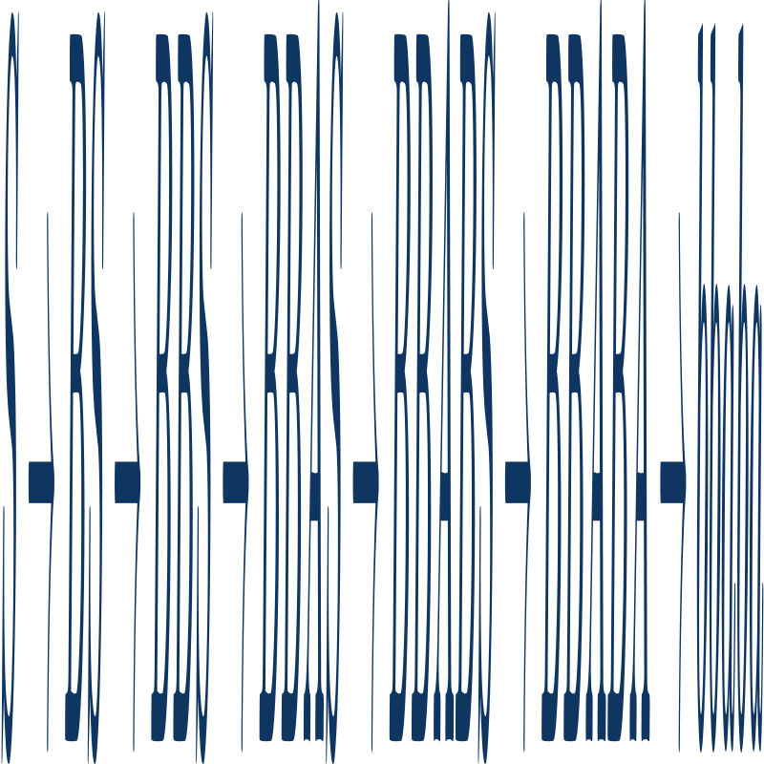
Context Free Grammars
8/39

Slide 9
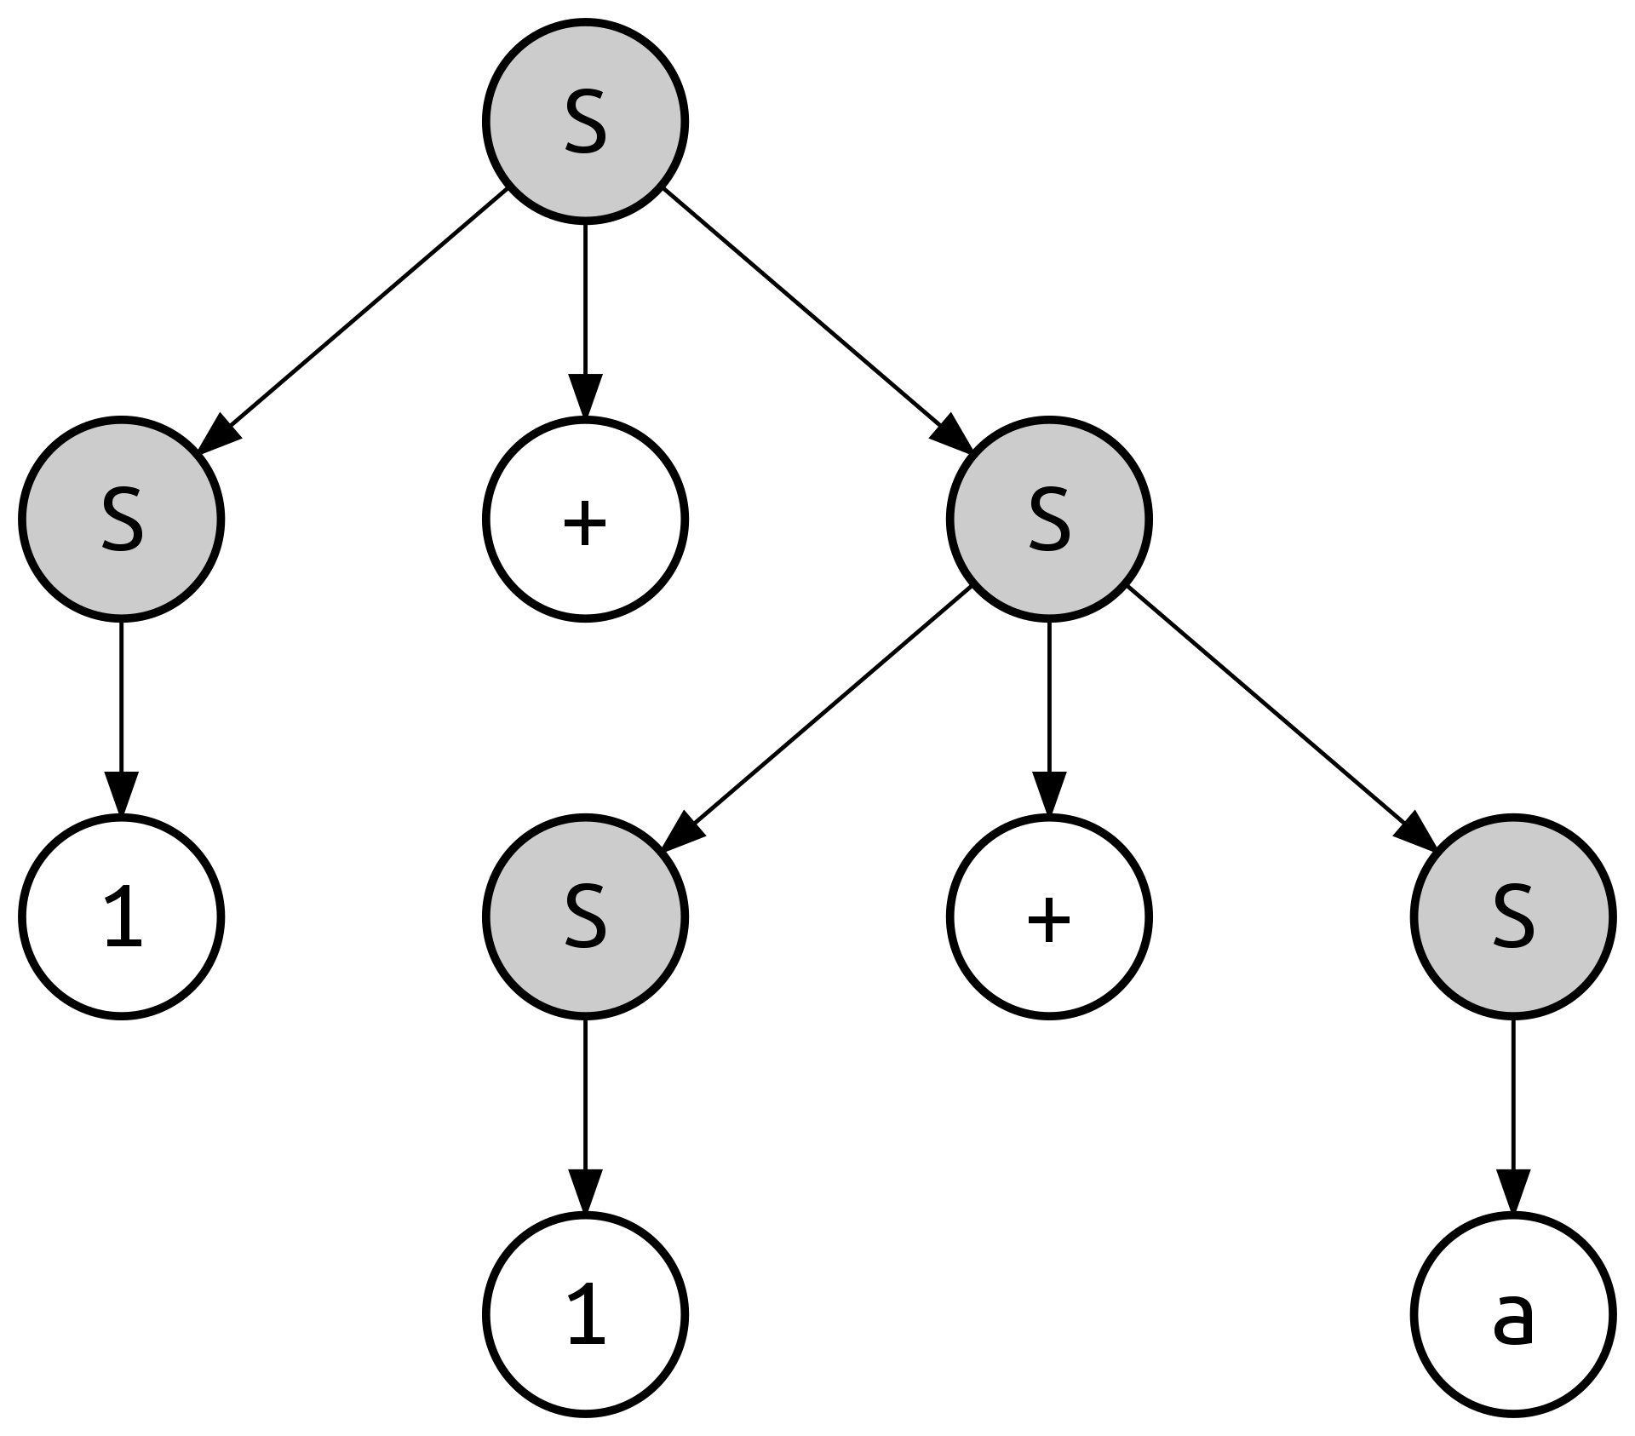



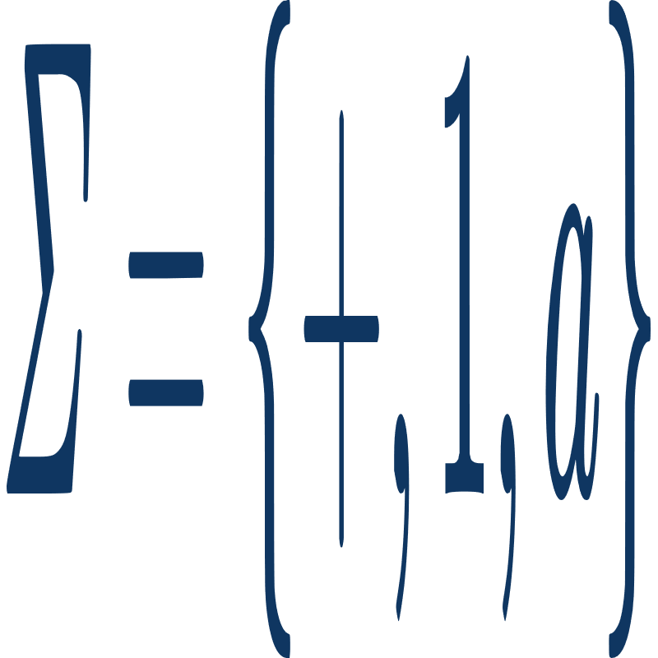


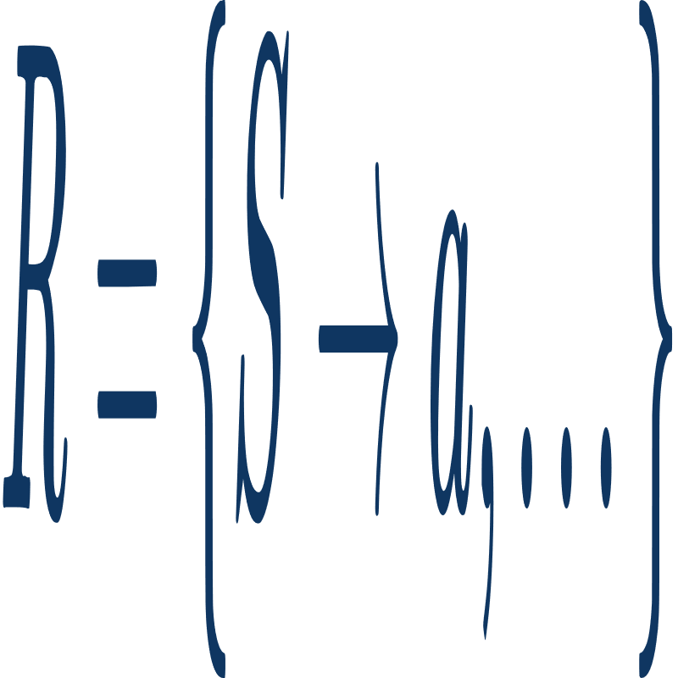

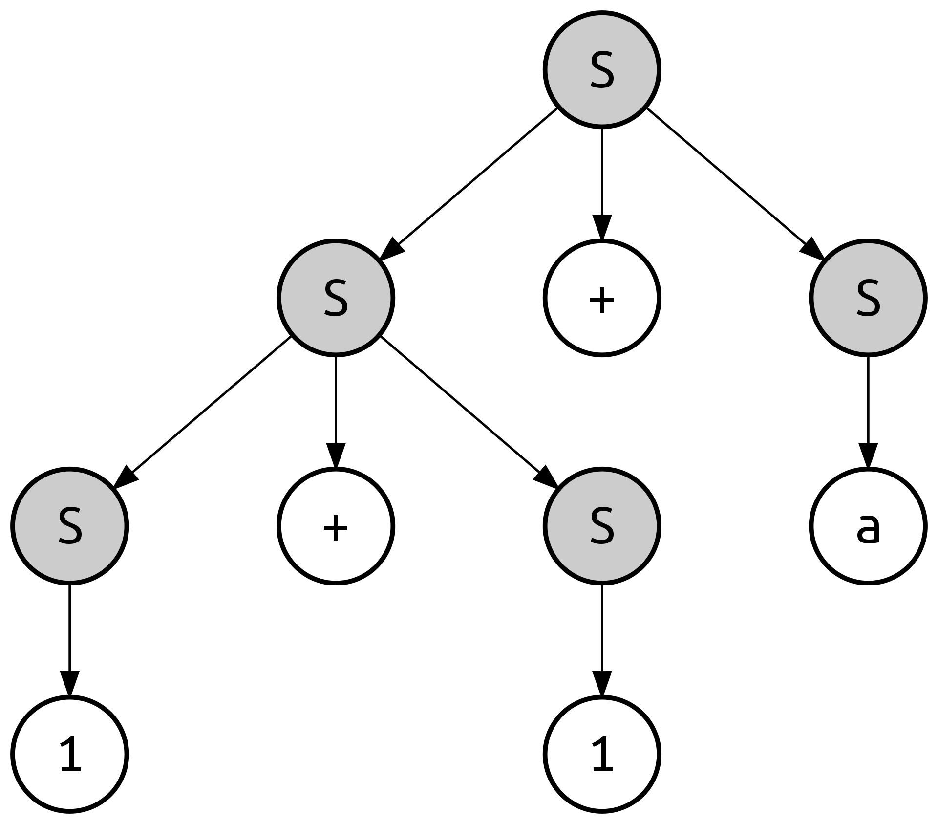

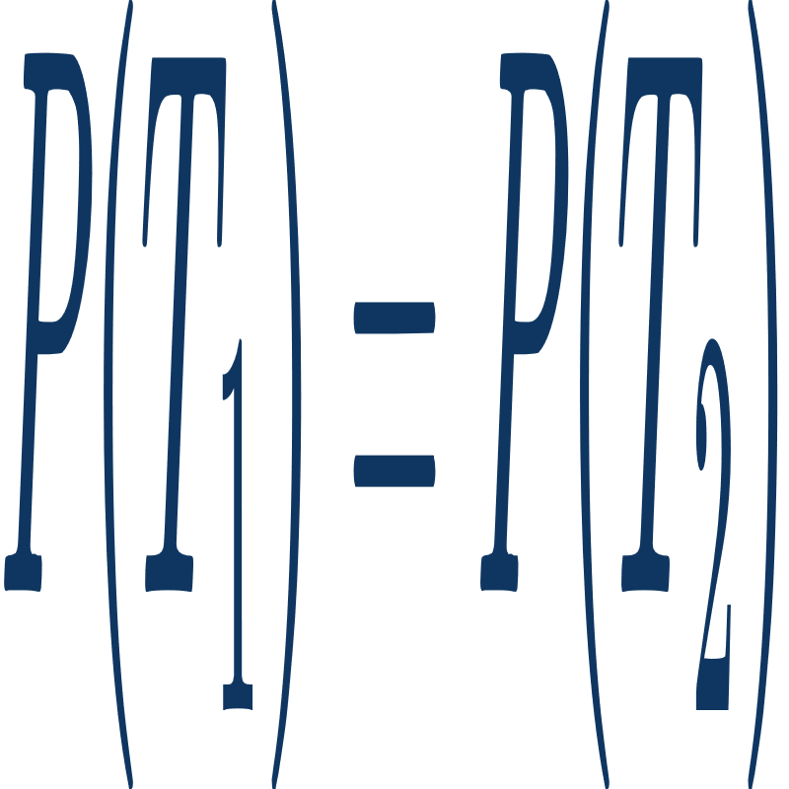
Stochastic Context Free Grammars
Stochastic
+ P
60%
30%
10%
05%
05%
= 0.6 * 0.6 * 0.3 * 0.3 * 0.1
This is Not Always true in PCFG.
9/39

Slide 10
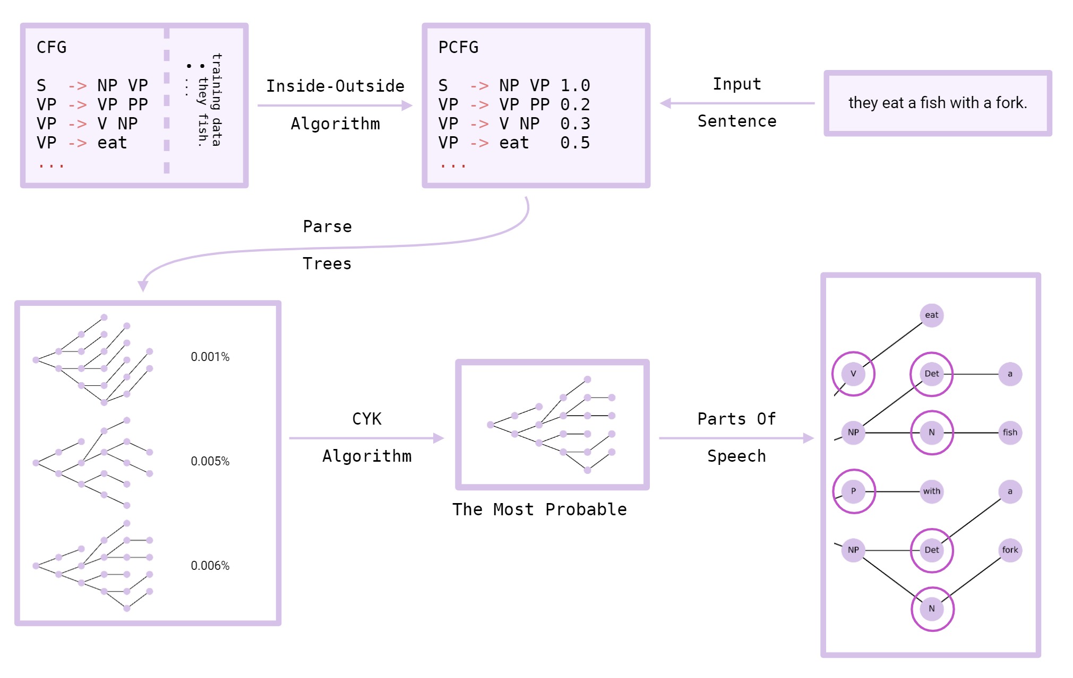
Parts Of Speech
10/39

Slide 11
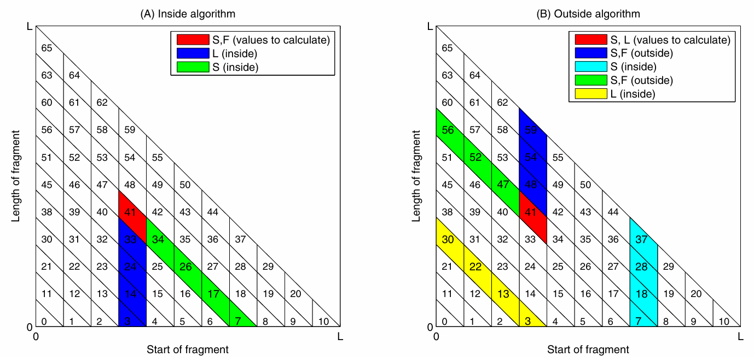
Inside Outside Algorithm
11/39

Slide 12
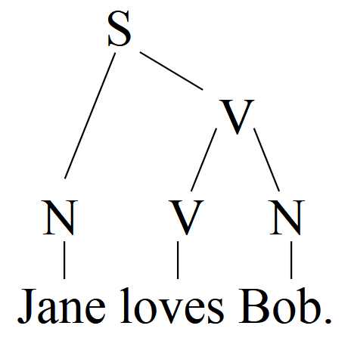
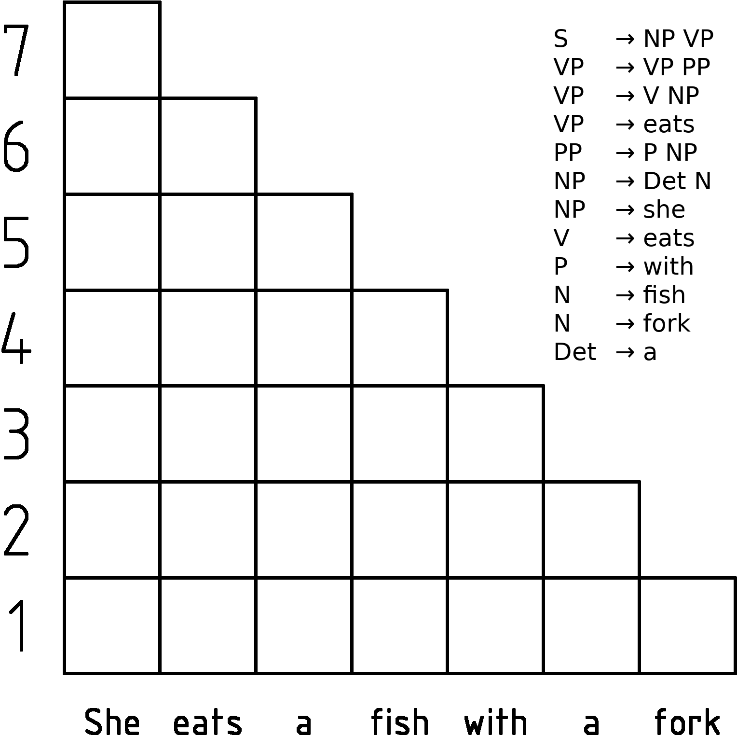
Cocke Younger Kasami Algorithm
12/39

Slide 13
Back To The Problem
A
A
A
A
A
A
A
A
A
C
A
A
A
A
G
A
A
A
A
U
A
A
A
C
A
->
?!
Terminals
...
Thus, we need to calculate all possible columns’ probablities, in two state of being single base or pair base.
13/39

Slide 14
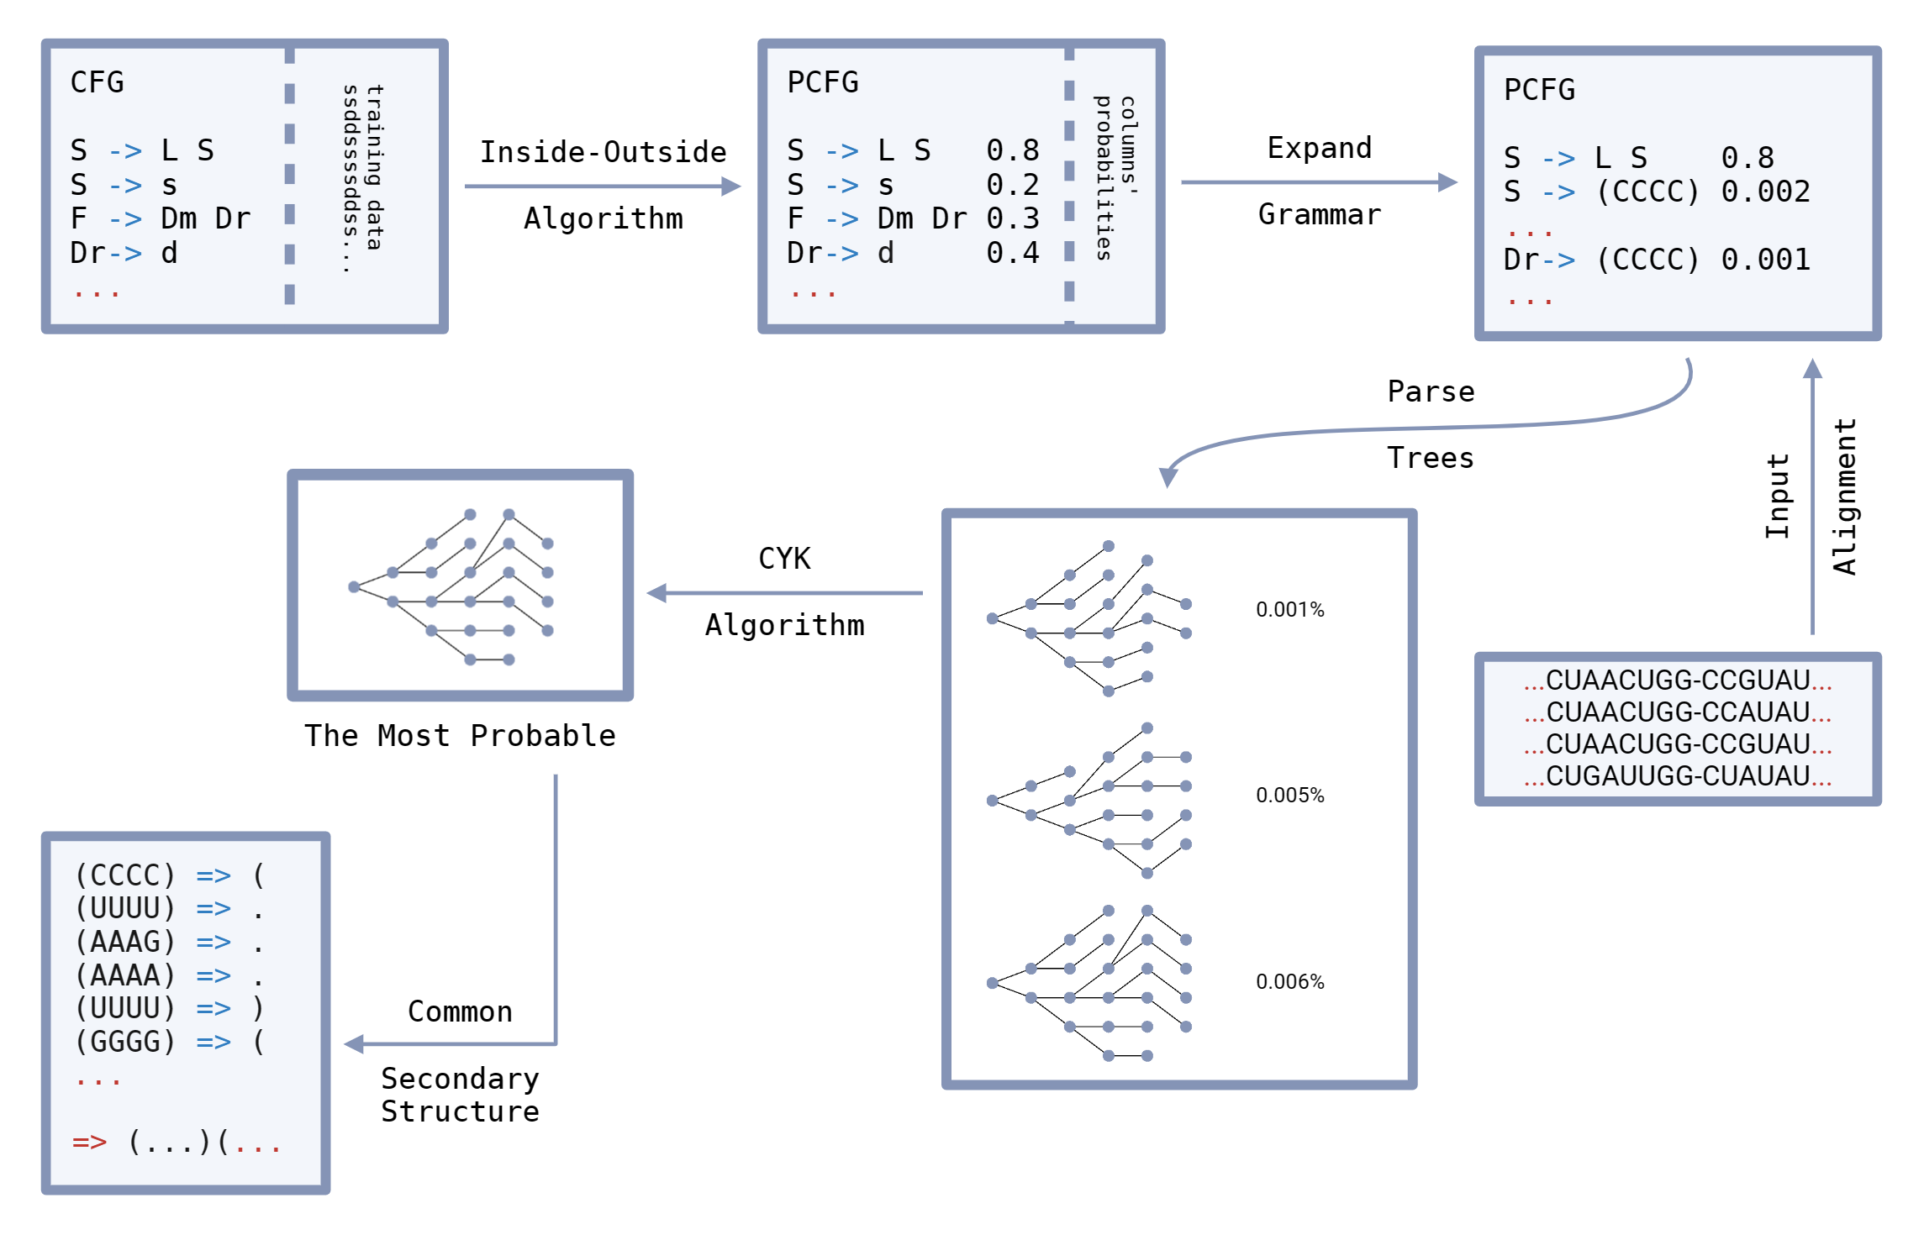
The Full Model
14/39

Slide 15
Grammars
For Secondary Structure
KH99
S → LS|s
L → s|dFd
F → LS|dFd
GG1
A → AA|BA|.|(A)|(C)
B → .|(C)
C → BA|(C)
KH99’
A → BA|.
B → .|(C)
C → BA|(C)
G2,6*
A → BB|.|BA
B → AB|(B)|A
15/39

Slide 16
03
Estimating Probabilities

Slide 17
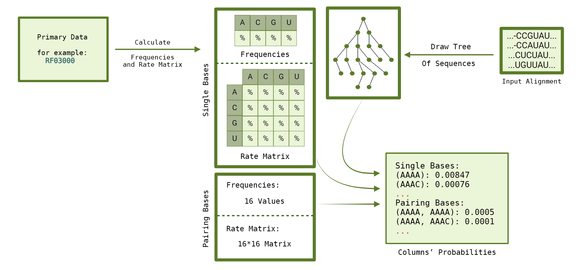
Columns’ Probability
17/39

Slide 18
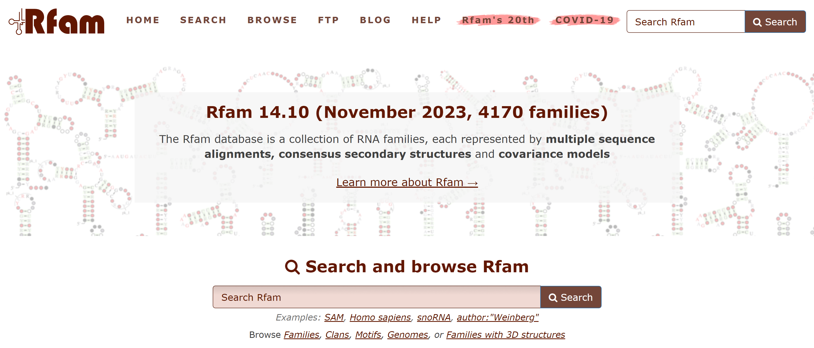
Primary Data
18/39

Slide 19
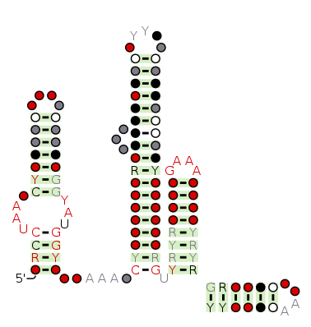
Primary Data
Family name : LOOT (RF03000)
Number of taxa : 368
Number of sites : 203
File format : Stockholms
19/39

Slide 20
Stockholm
.
.
.
URS0000D69AA2_12908/1-122 AGCC-UAAG-UCCC-----------GCAA------------------GG...
URS0000D6C6EB_12908/1-121 AGCC-UAAG-UCCC-----------GCAA------------------GG...
URS0000D6D2FE_12908/1-130 GACC-UAAC-CCCUAUG--------UUUU---------------CAUAA...
URS0000D6BC04_12908/1-128 GACC-UAAC-CCUUGA---------UUUA----------------UCGA...
URS0000D67350_12908/1-147 UGCC-UAAC-CCCUAUAUCAUUUGGCGAUUU-----CC----GAUGUAA...
URS0000D69F1F_12908/1-127 AGCC-UAAG-UCCU-----------GCACAA----------------AG...
URS0000D6BC23_12908/1-118 GACC-UAAA-CUCAC----------UUU------------------GUG...
#=GC SS_cons <<<<------<<<<<<<._________________________.>>>>>...
.
.
.
Matching nested parentheses characters <>, (), [], or {} indicate a basepair. The symbols '.', ',' and ';' indicate unpaired regions.
20/39

Slide 21
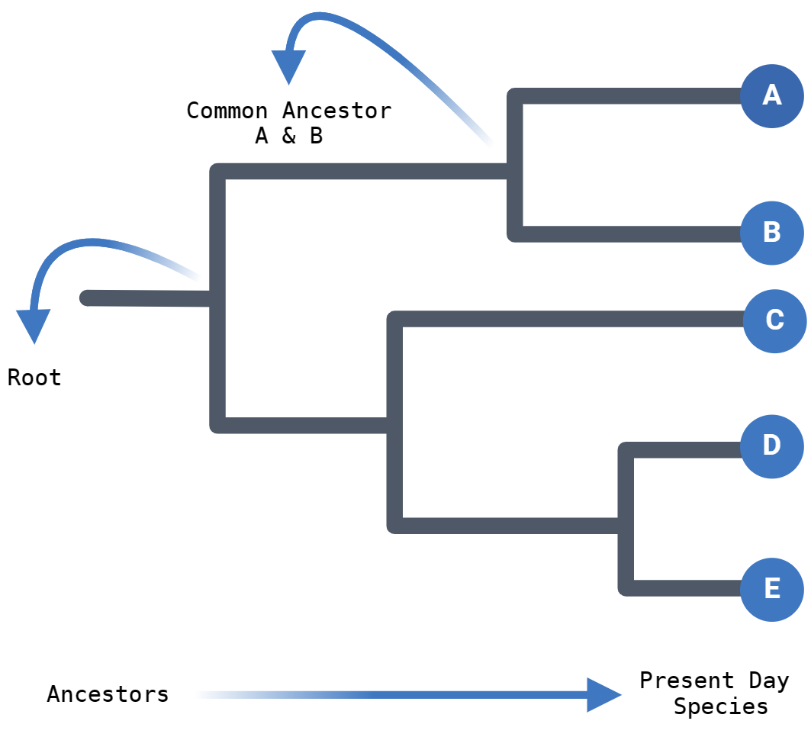
Phylogenetic Tree
21/39

Slide 22
Newick
((Seq5:0.00003,Seq4:1.00549):0.27944[10.98],
(Seq1:0.09537,(Seq2:0.41900,Seq3:0.52322):0.22002[5]):0.54170[40.72]);
22/39

Slide 23
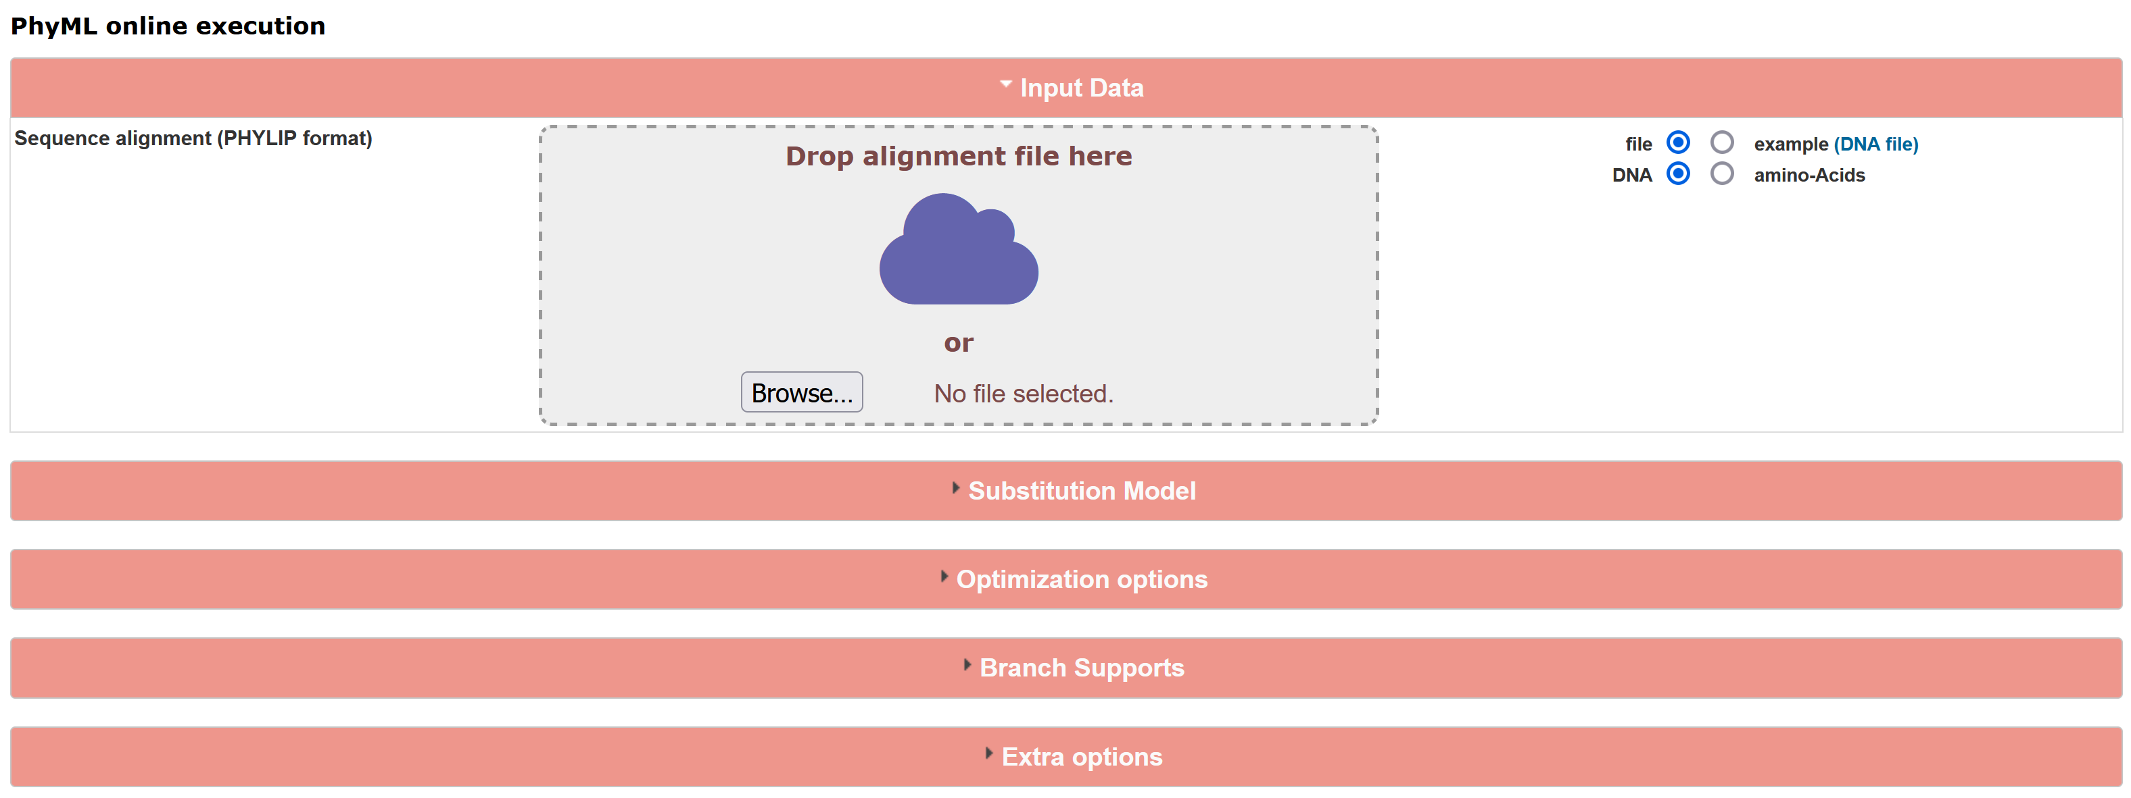
PhyML
23/39

Slide 24
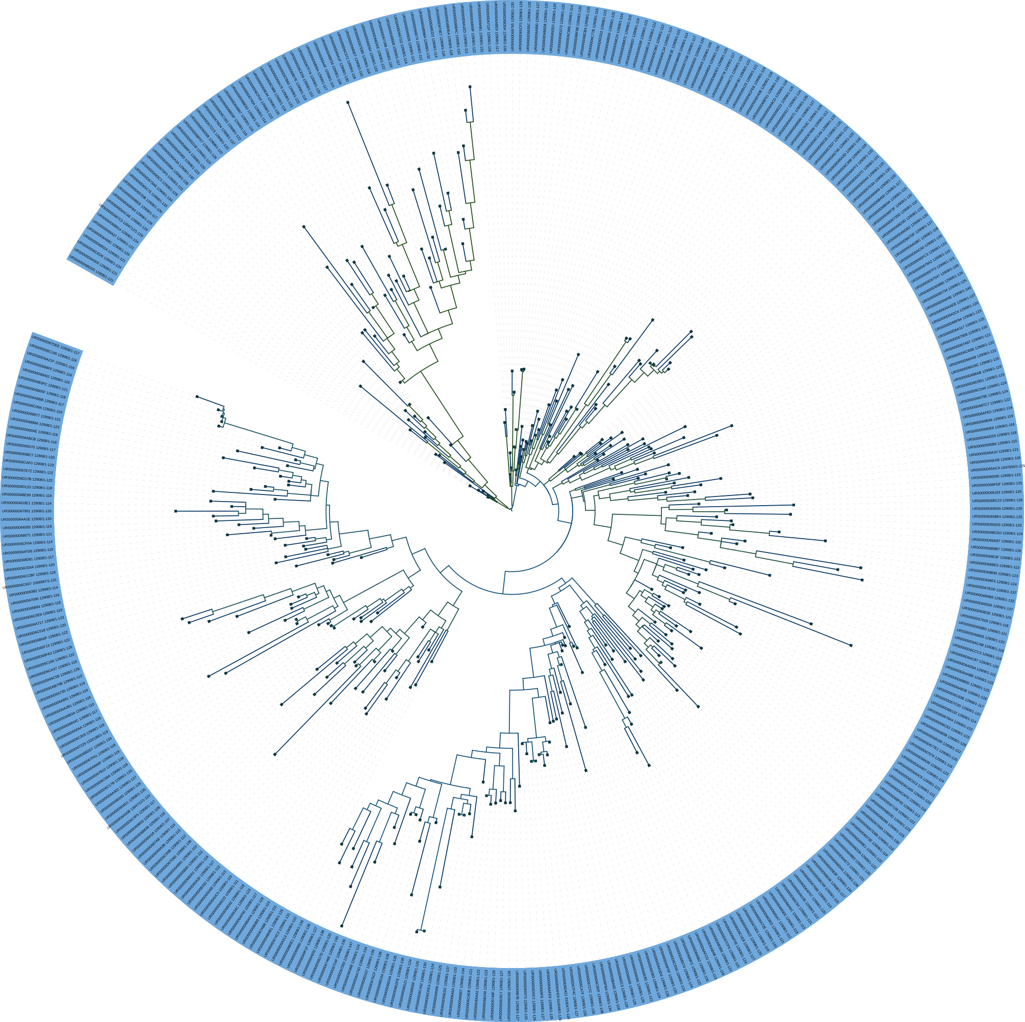
Phylogenetic Tree
LOOT (RF03000)
24/39

Slide 25
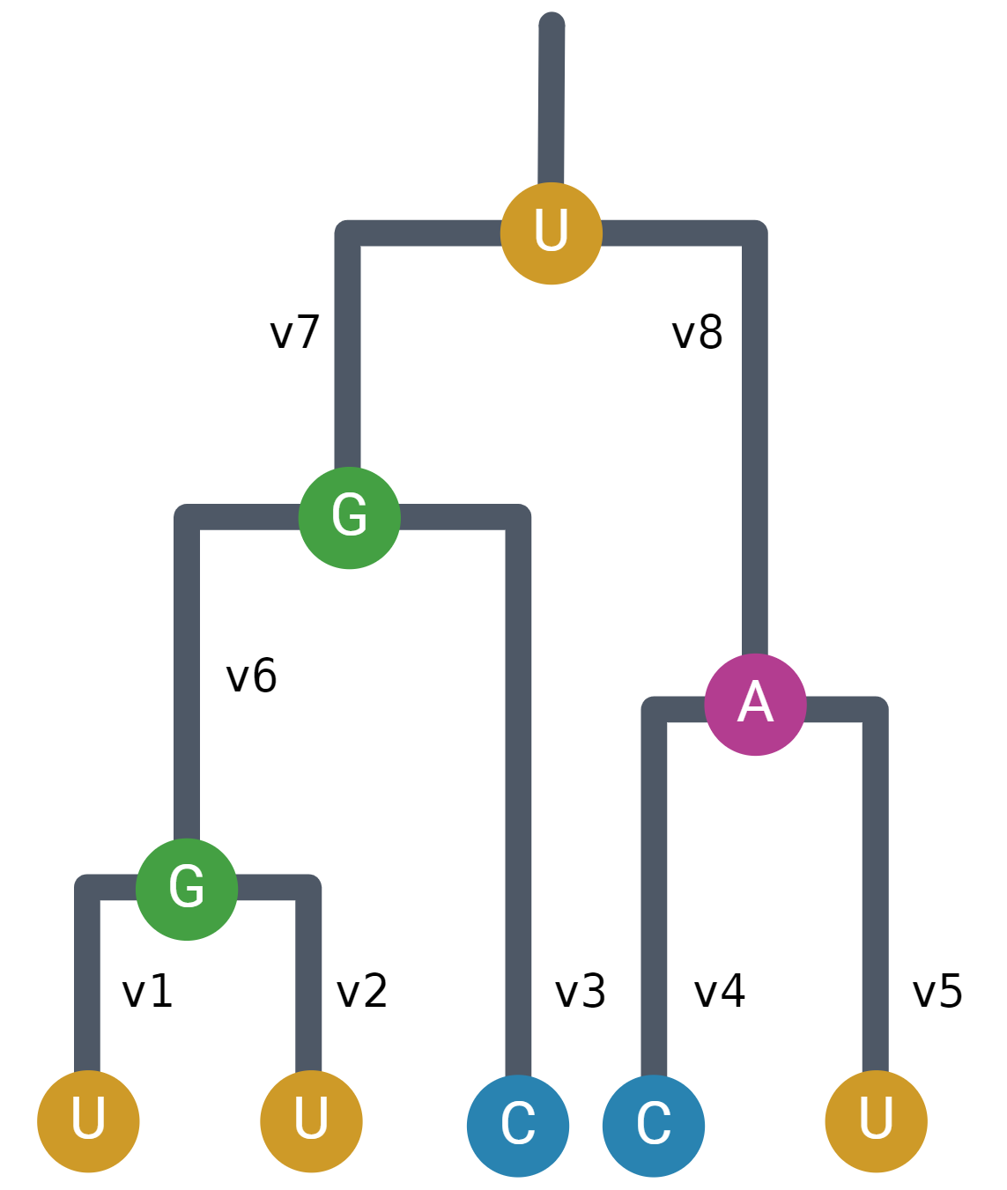
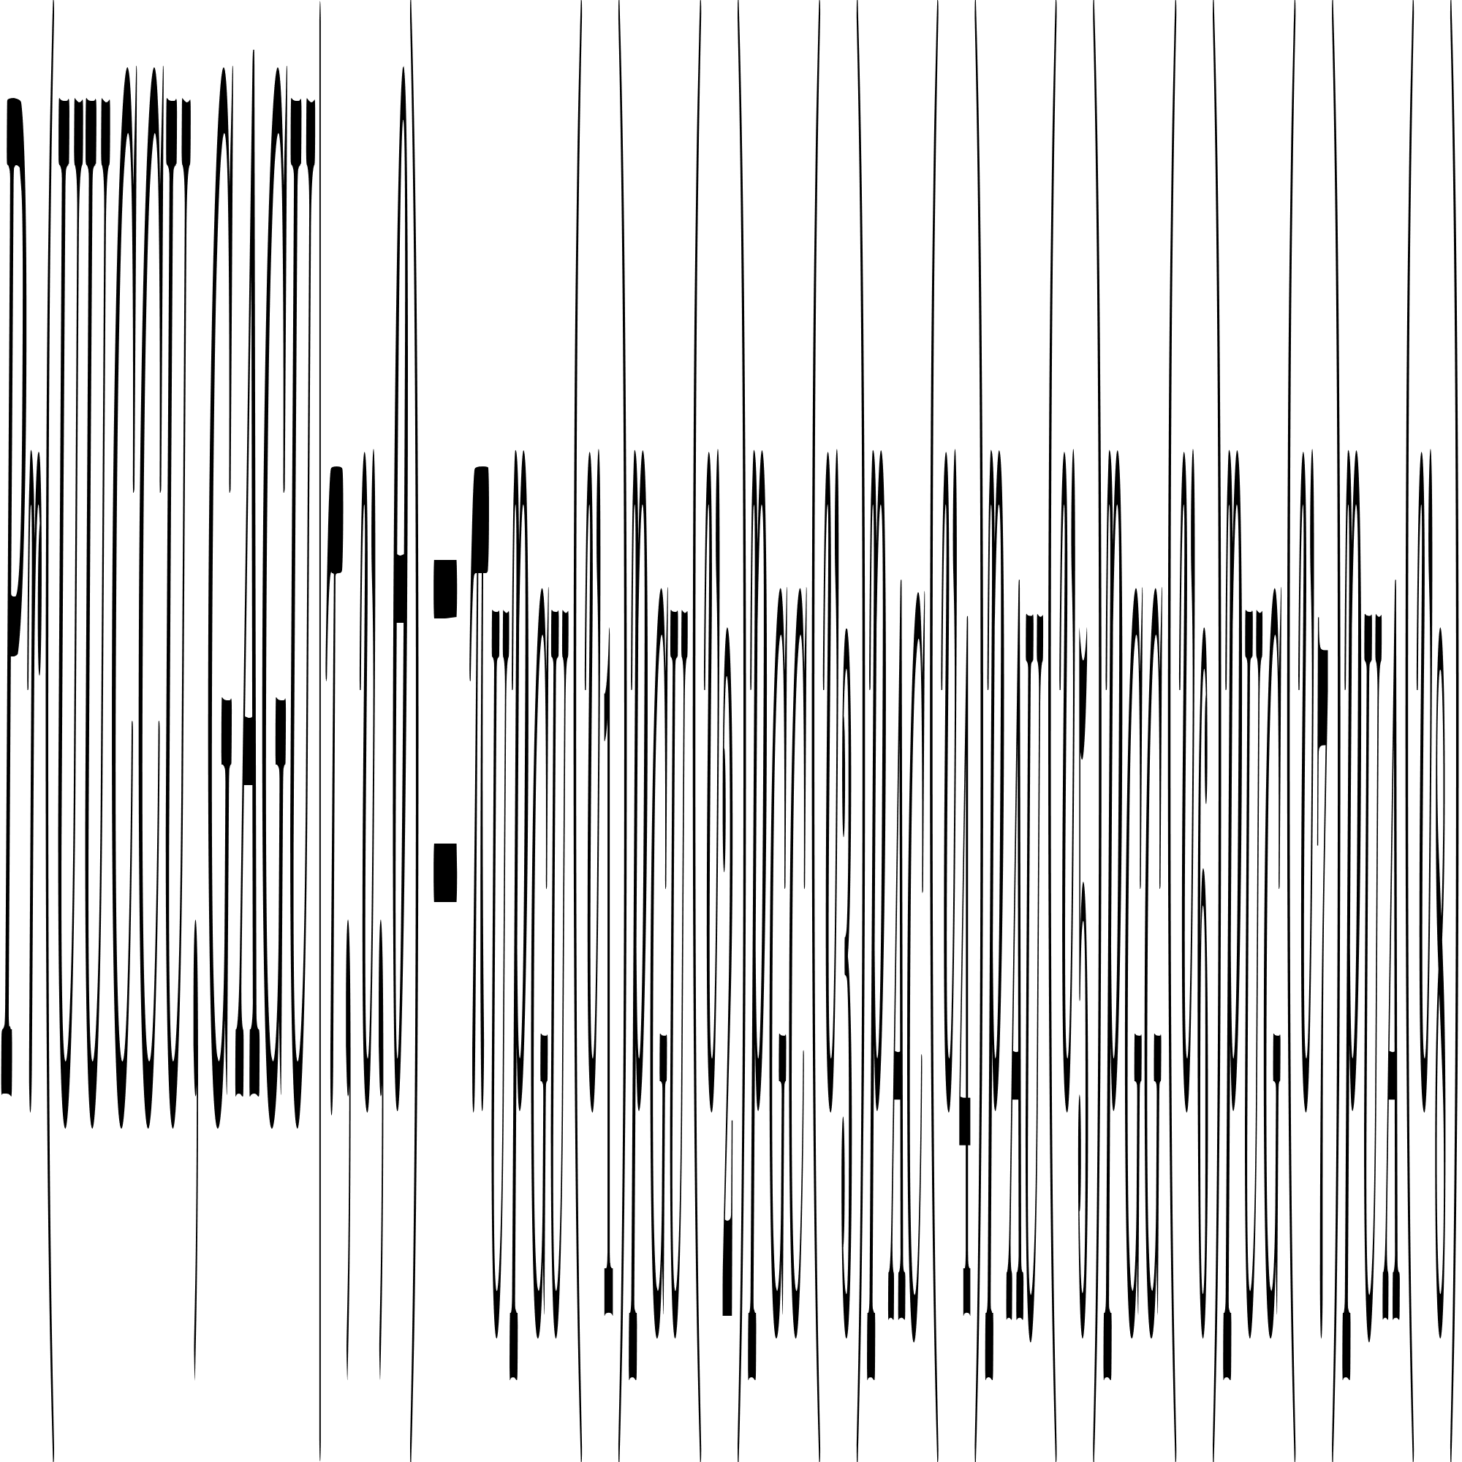
Columns’ Probabilities
seq1
seq2
seq3
seq4
seq5
25/39

Slide 26
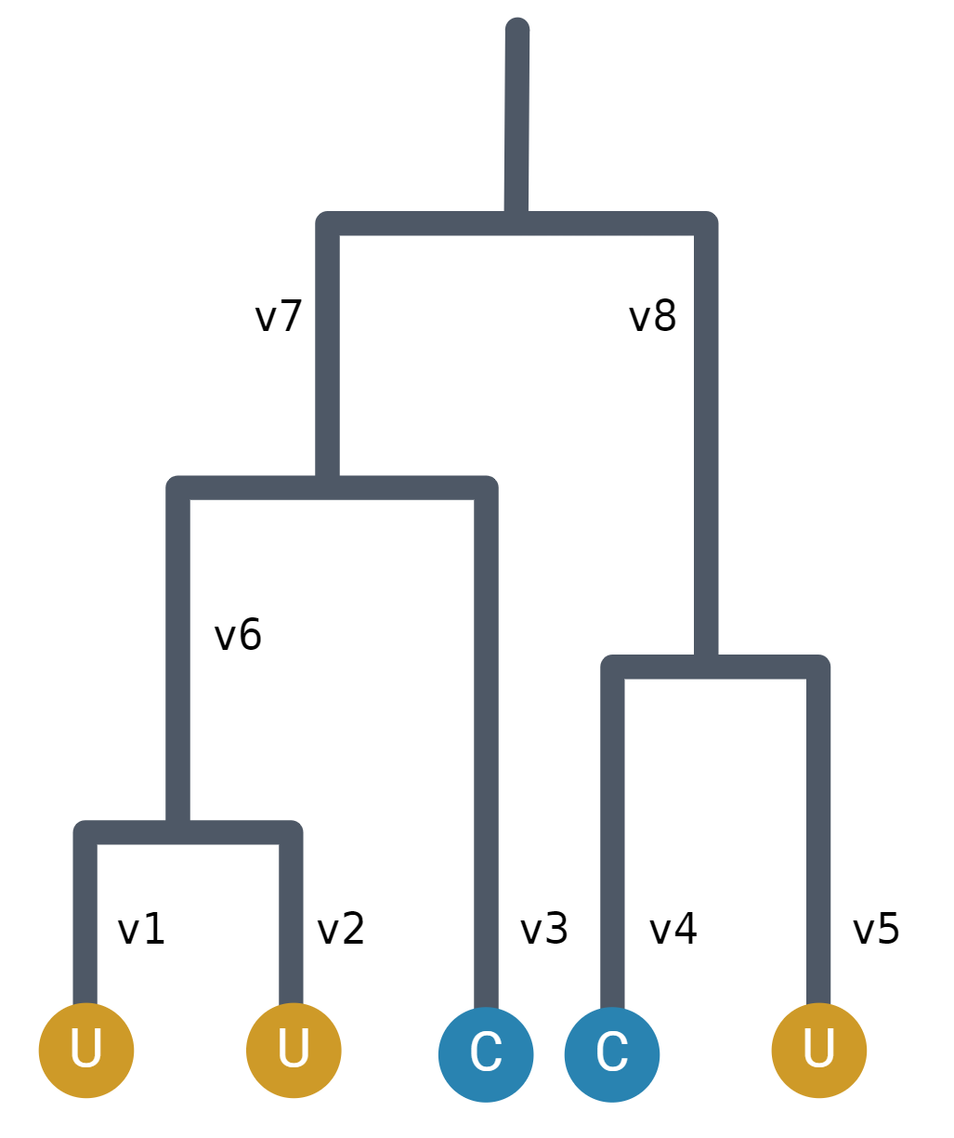
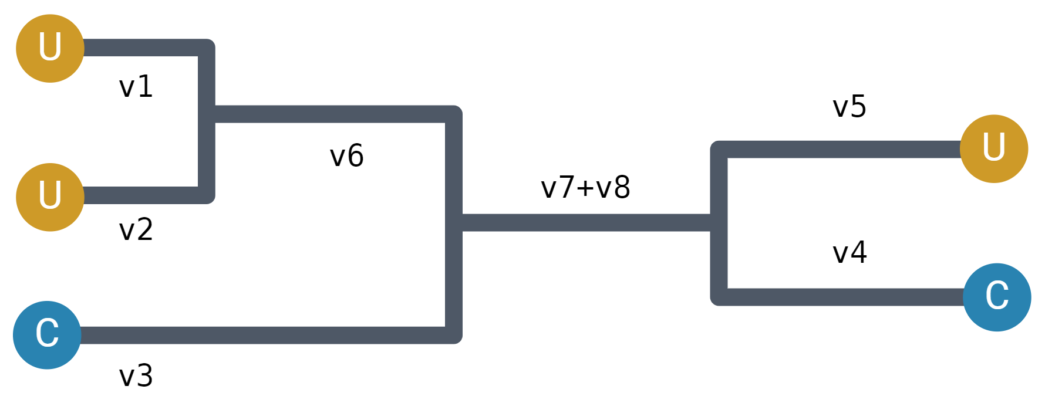
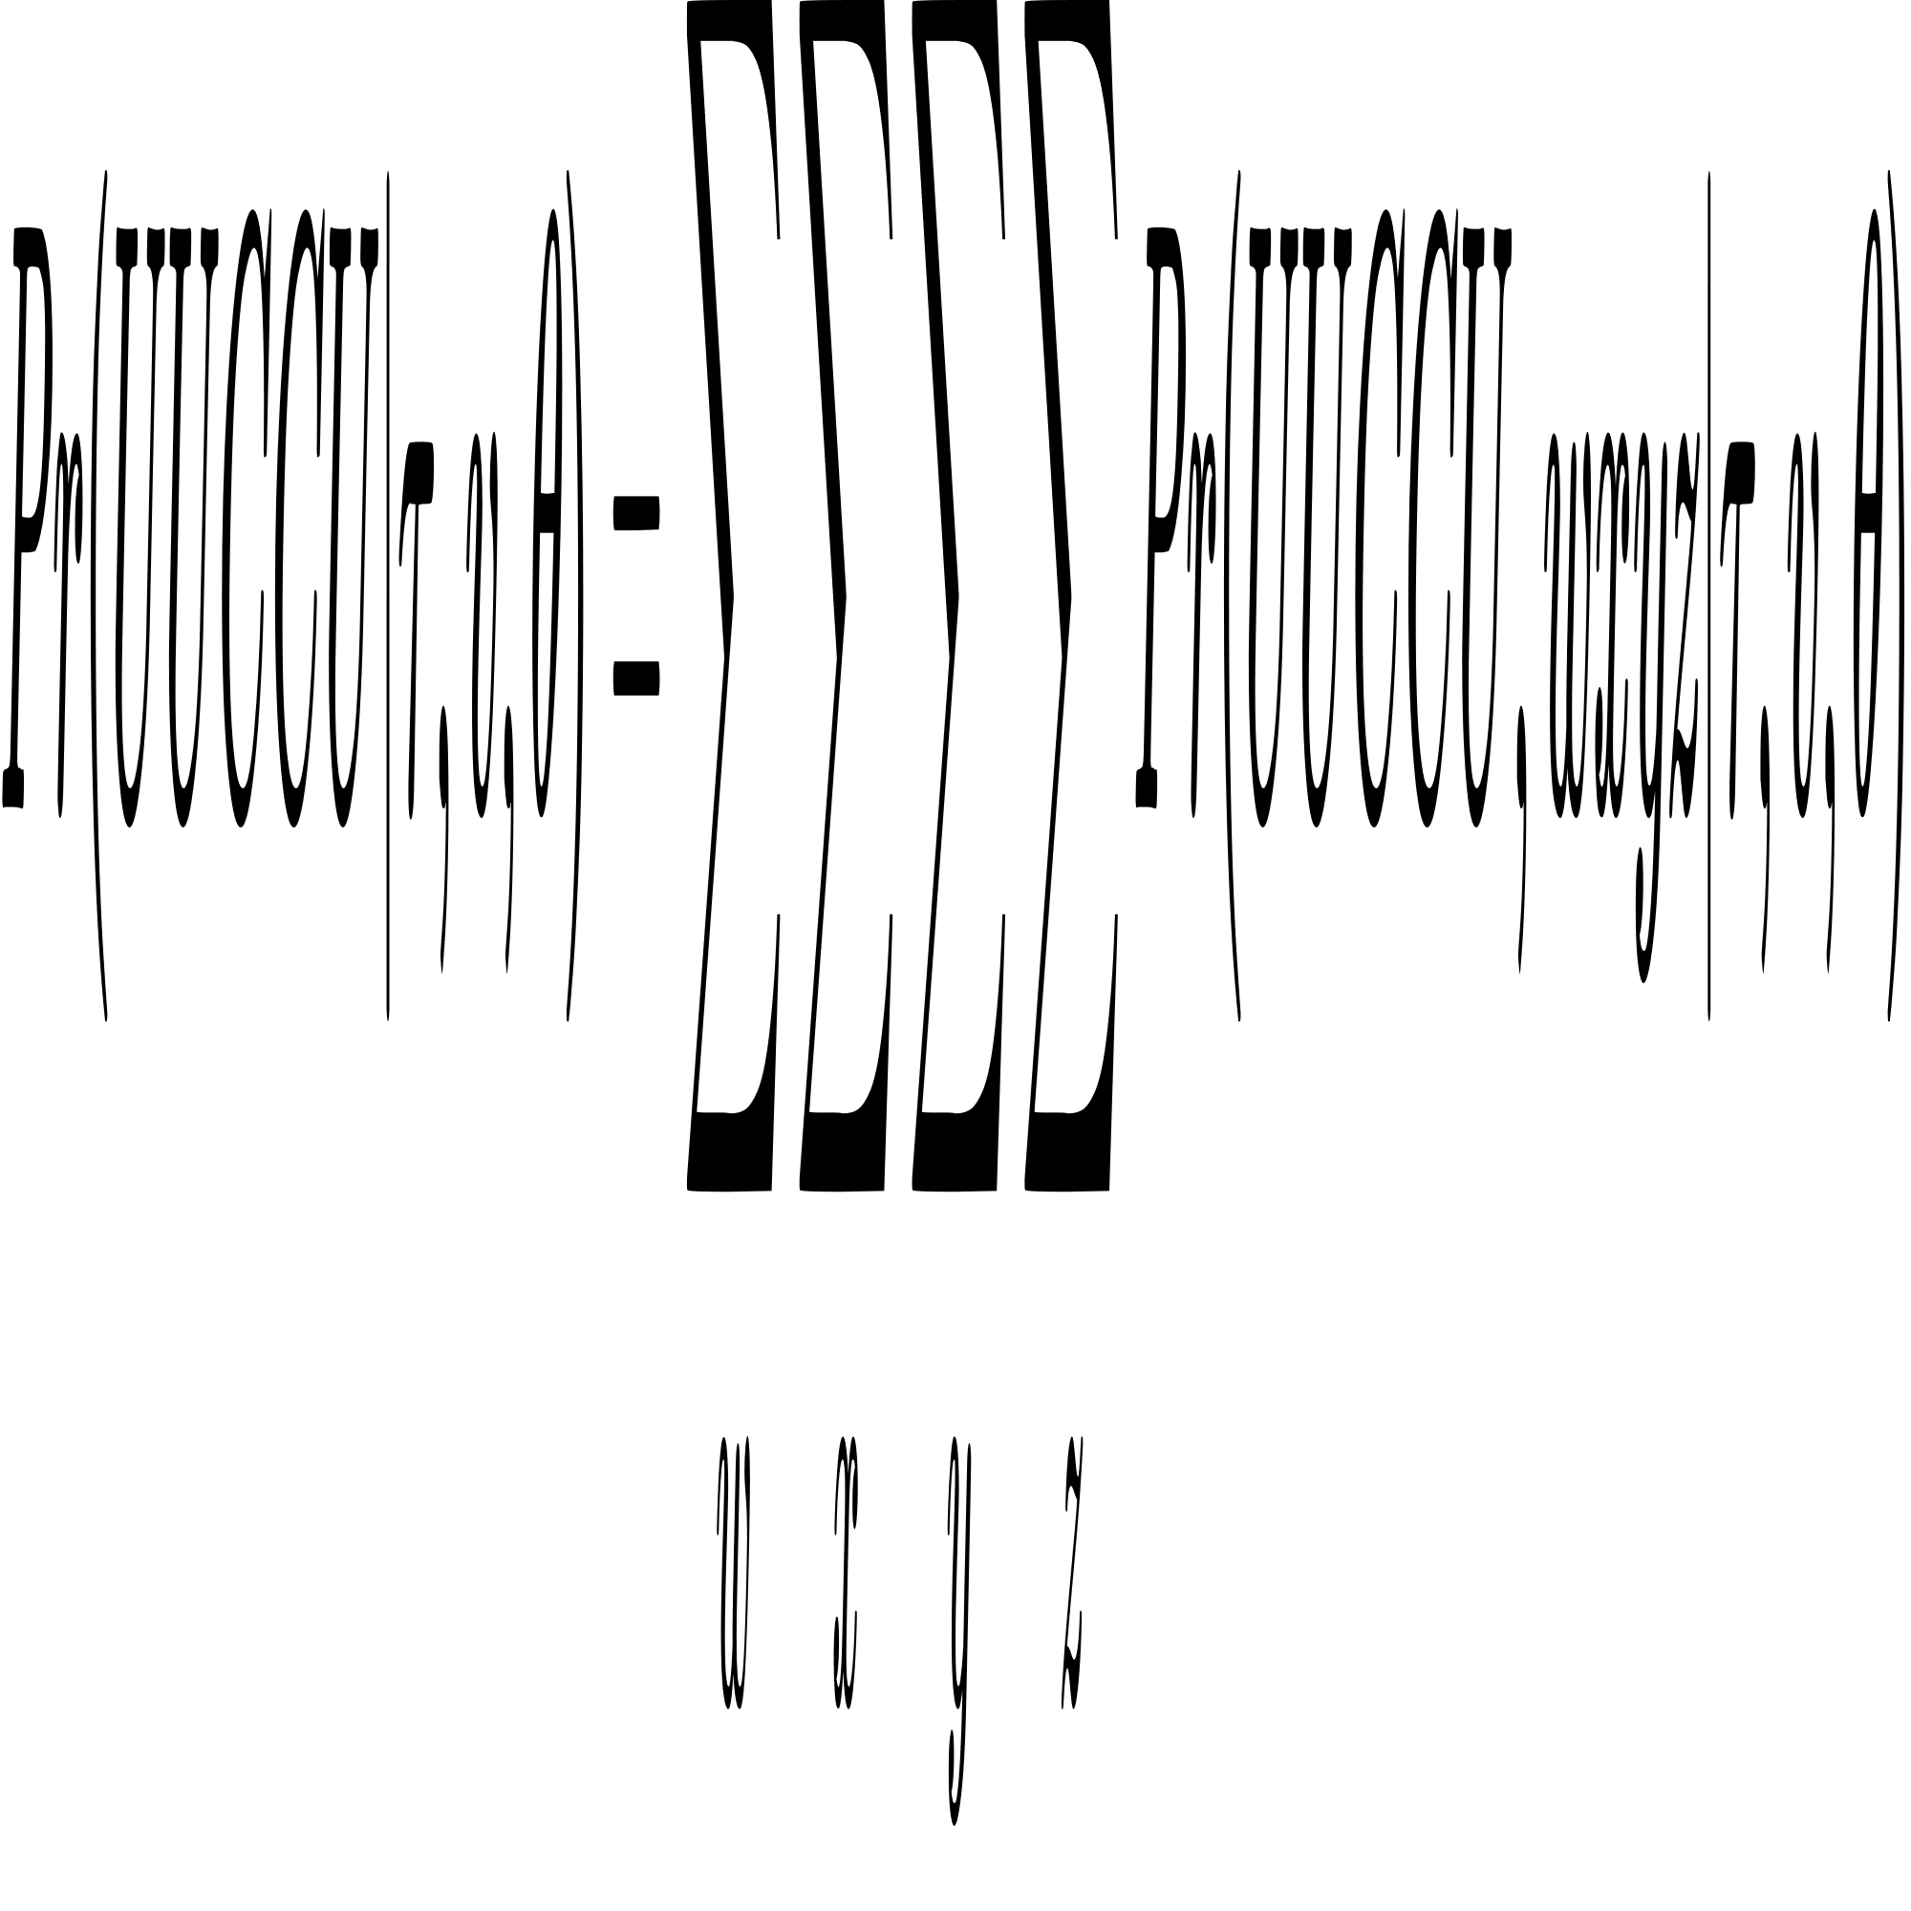
Columns’ Probabilities
midpoint
seq1
seq2
seq3
seq4
seq5
26/39

Slide 27
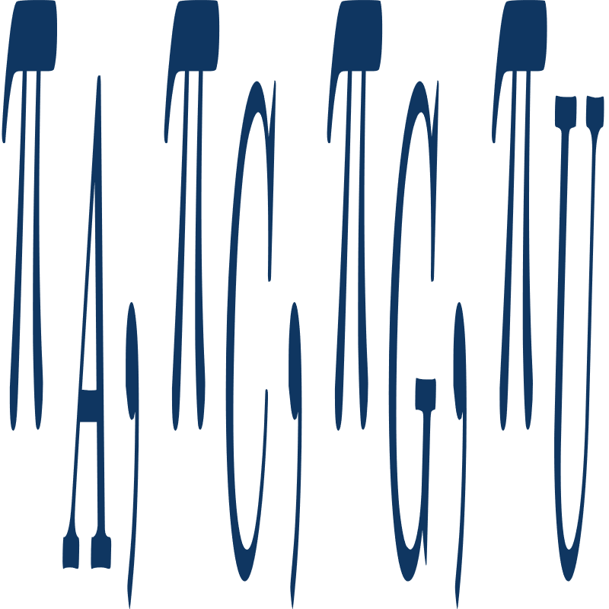
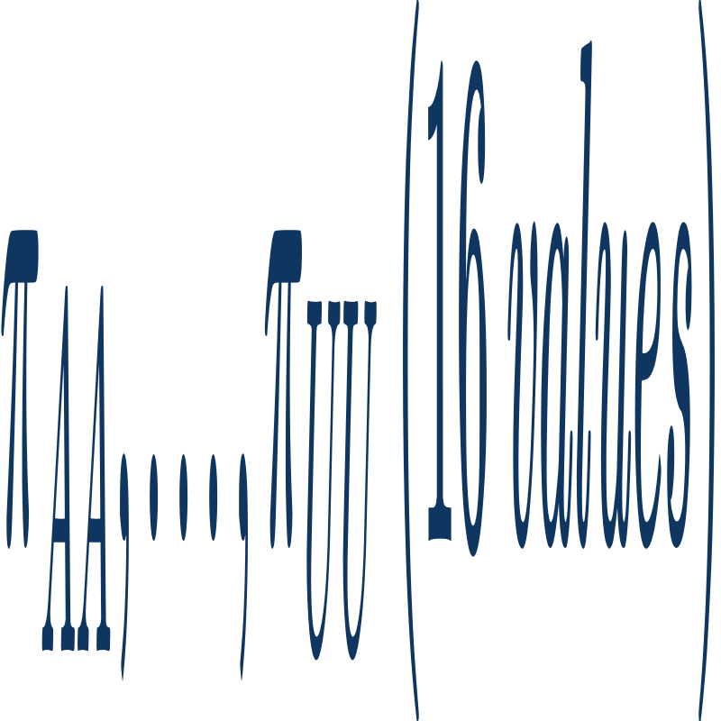
Calculating Frequencies
Non-pairing Bases:
Counting A, C, G and U
Finding each ratio to all non-pairing bases
Pairing Bases:
Counting AA, AC, AG, AU and ...
Finding each ratio to all base pairs
27/39

Slide 28

Calculating Frequencies
Total Ratio:
Ratio of both pairing/non-pairing bases to all bases.
(Using later)
Example:
Stem |  | Loop
AU/UA | 33.9% | A | 44.0%
CG/GC | 52.0% | C | 16.8%
GU/UG | 08.9% | G | 14.3%
Others | 05.2% | U | 24.9%
Total | 66.9% | Total | 33.1%
28/39

Slide 29
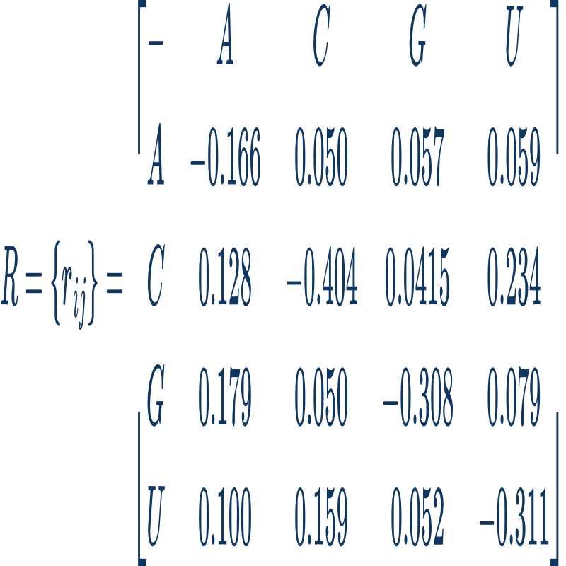
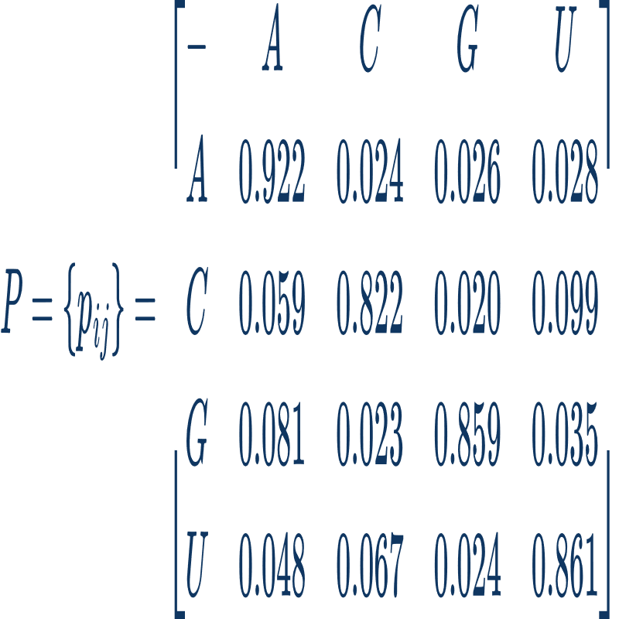
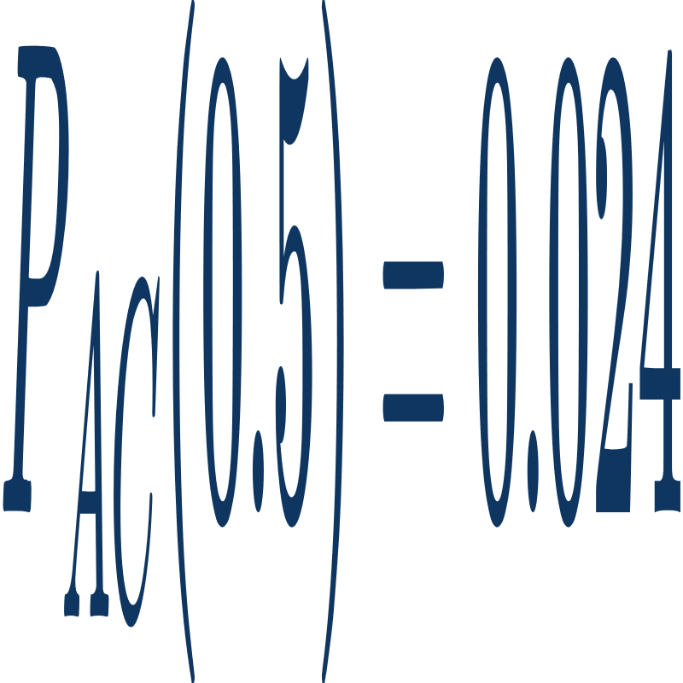
Calculating Mutation Probabilities
Steps
Mutation rate matrix (R)
Mutation probability matrix (P)
Mutation probability
Example:
1)
2)
3)
29/39

Slide 30
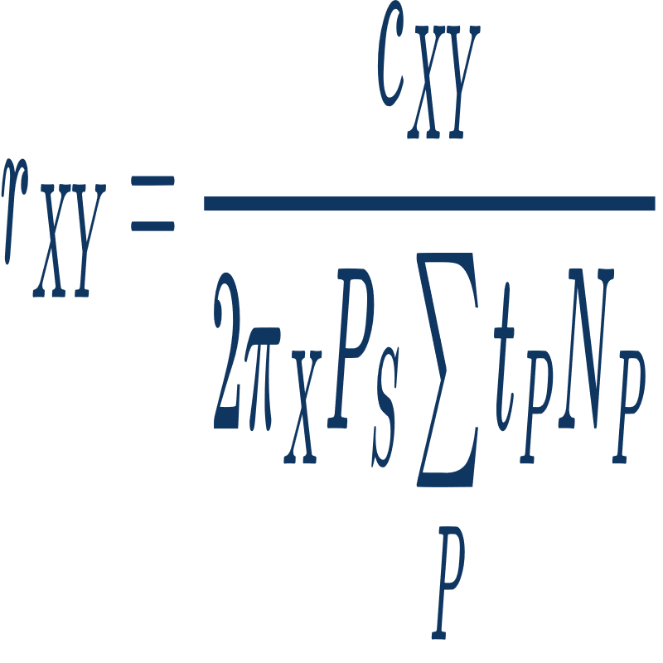
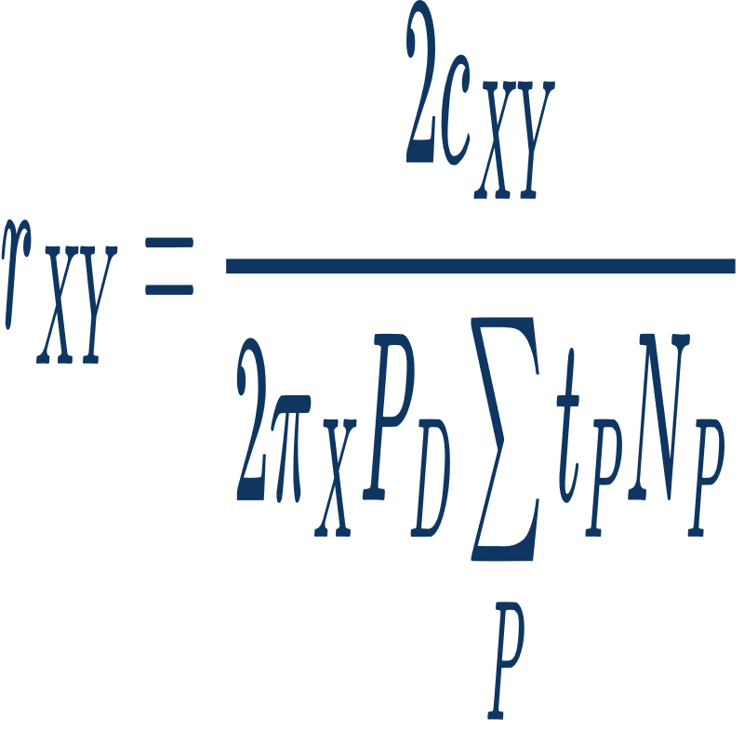
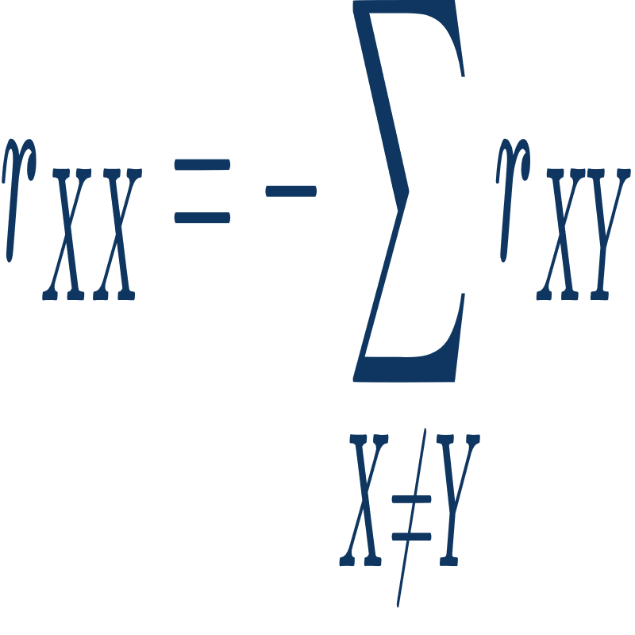
Calculating Mutation Probablities
In R matrix for X ≠ Y:
( P: pairs with at least 85% similarity )
Other R matrix values:
30/39

Slide 31
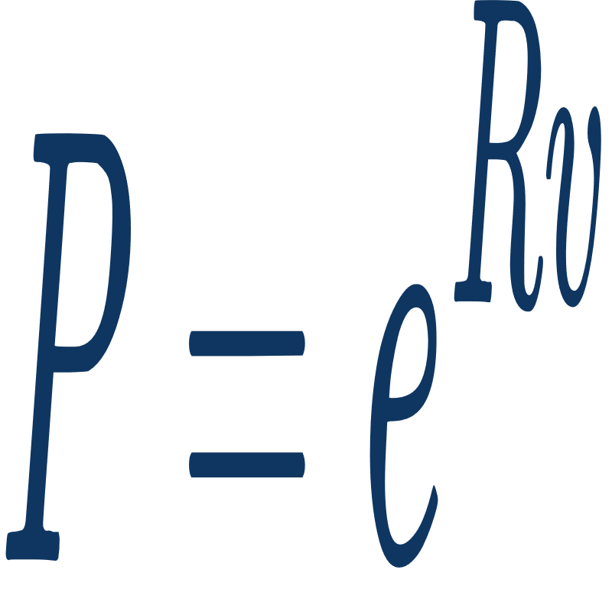
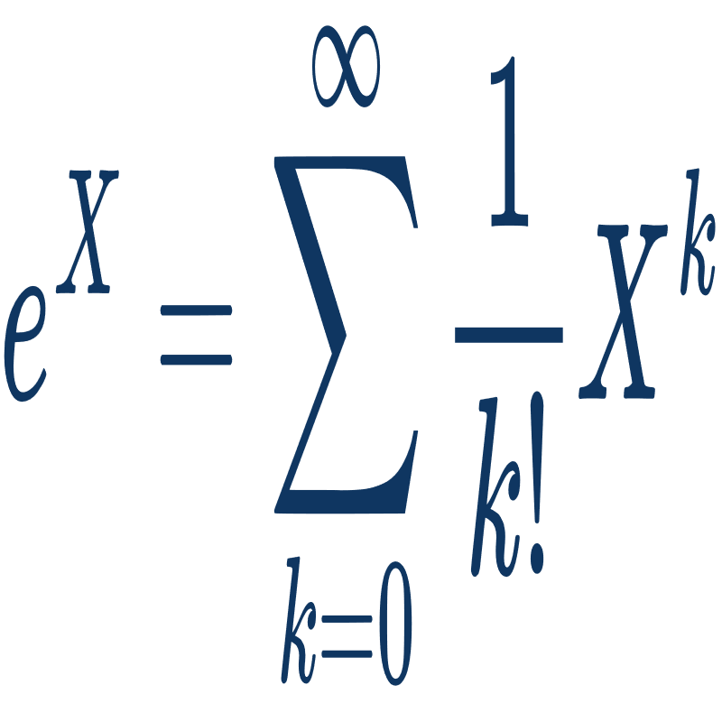
Calculating Mutation Probabilities
Mutation probability matrix (P):
Exponential of matrix:
Select probability :)
31/39

Slide 32
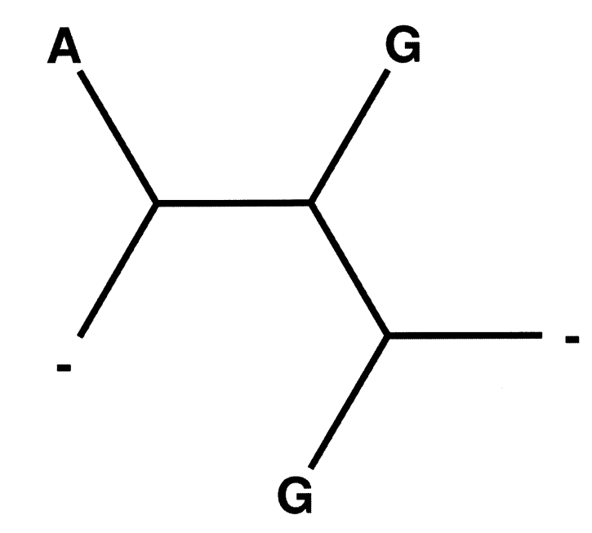
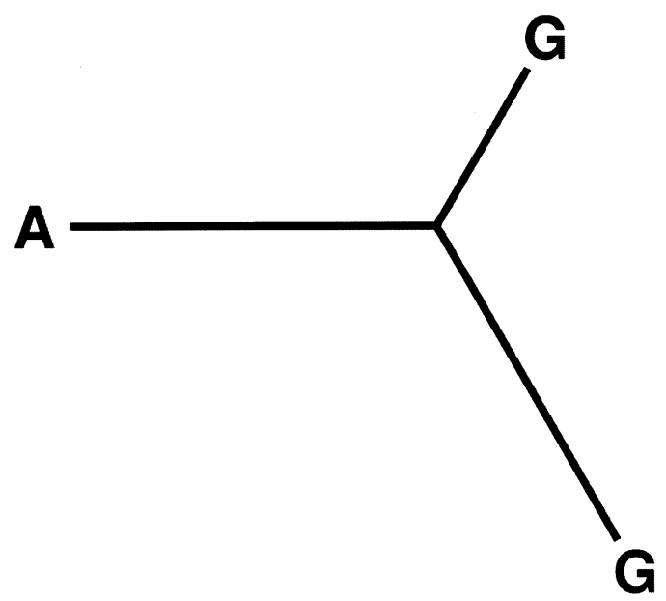
Treating Gaps
Treating as 5th nucleotide
Gap cannot be viewed as evolving in the same way as a nucleotide
Treating as unknown nucleotide
The method used for calculating the probability of columns containing gaps.
32/39

Slide 33
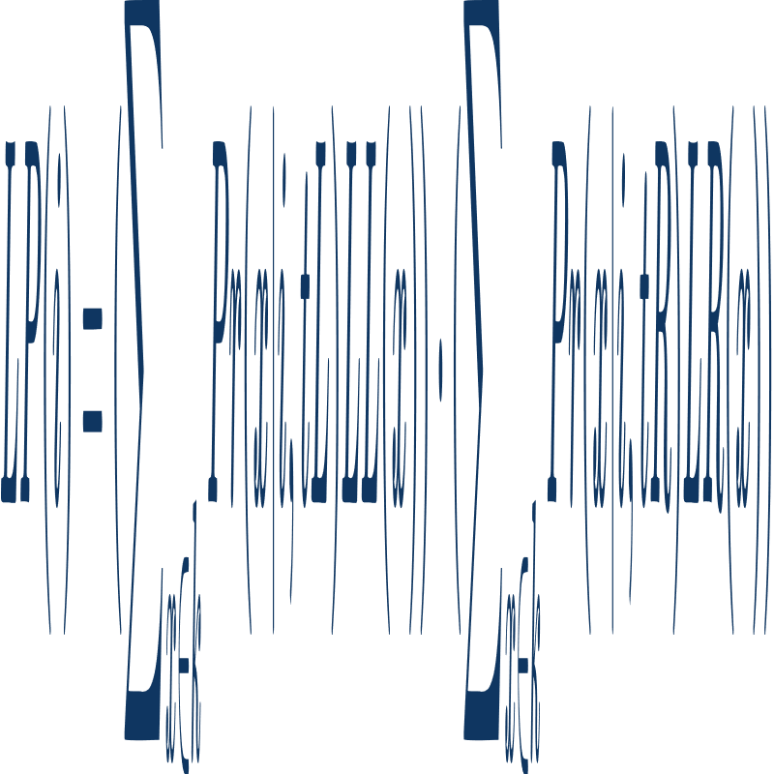
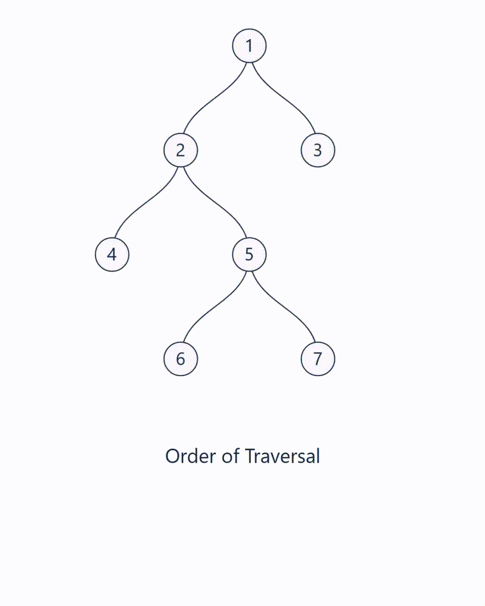
Felsenstein's Pruning Algorithm
33/39

Slide 34
04
Implementation

Slide 35
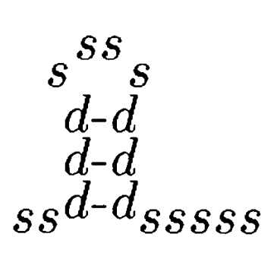
Inside Outside Algorithm
S -> L S
S -> Dm Dr
F -> Dm Dr
F -> L S
L -> Dm Dr
Dm -> Dl F
S -> s
L -> s
Dl -> d
Dr -> d
S -> L S 0.92
S -> Dm Dr 0.02
F -> Dm Dr 0.82
F -> L S 0.18
L -> Dm Dr 0.05
Dm -> Dl F 1.0
S -> s 0.06
L -> s 0.95
Dl -> d 1.0
Dr -> d 1.0
... ((((((................)))))) ...
(In Stockholm File)
+
=
Terminal ‘s’ stands for a single base, and ‘d’ stands for a pairing base.
35/39

Slide 36
Extending Grammmar
After calculating columns’ probabilities:
S -> L S 0.92
S -> Dm Dr 0.02
F -> Dm Dr 0.82
F -> L S 0.18
L -> Dm Dr 0.05
Dm -> Dl F 1.0
S -> s 0.06
L -> s 0.95
Dl -> d 1.0
Dr -> d 1.0
S -> L S 0.92
S -> ('A','A',’A’) 0.00847
S -> ('C','A',’A’) 0.00015
S -> ('G','A',’A’) 0.00017
S -> ('U','A',’A’) 0.00018
S -> ('A','C',’A’) 0.00014
S -> ('C','C',’A’) 0.00294
S -> ('G','C',’A’) 0.00005
...
+
Columns’ Probabilities
=
By running CYK on extended grammar, we can get the secondary structure by checking which rule reached the terminal ( Dl -> ‘(’ , Dr -> ‘)’ , others -> ‘.’ )
36/39

Slide 37
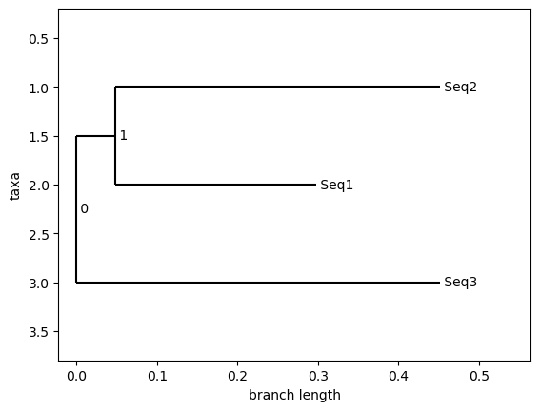
Example
Input:
Seq1: GGGCCUGUAGCUCAGAGGAUUAGAGCACGUGGCUACGAACCACGGUGUCGGGGGUUCGAAUCCCUCCUCGCCCA
Seq2: GGGCUAUUAGCUCAGUUGGUUAGAGCGCACCCCUGAUAAGGGUGAGGUCGCUGAUUCGAAUUCAGCAUAGCCCA
Seq3: GGCGCCGUGGCGCAGUGGA--AGCGCGCAGGGCUCAUAACCCUGAUGUCCUCGGAUCGAAACCGAGCGGCGCUA
Output:
Prediction: (((((((..((((.........))))((((((.......))))))....(((((.......)))))))))))).
RNAalifold: (((((((..((((.........)))).(((((.......))))).....(((((.......)))))))))))).
37/39

Slide 38
References
Lectures:
Secondary Structure Prediction (Knudsen B. and Hein,J. - 1999)
Secondary Structure Prediction (Knudsen B. and Hein,J. - 2003)
Calculating Likelihoods on Phylogenetic Trees (John P. Huelsenbeck - 2012)
The Inside-Outside Algorithm (Michael Collins)
Evolutionary Trees from DNA Sequences (Felsenstein - 1981)
Towards Optimal Grammars for RNA Structures (Sebastian Wild - 2024)
Books:
RNA Sequence, Structure and Function (Jan Gorodkin)
Biological Sequences Analysis (R. Durbin)
38/39

Slide 39
Thanks For Your Attention

